Slide 1

Mechatronics – 302050
Lecture Notes / PPT
UNIT II

Slide 2
Syllabus
Block Diagram Representation
Introduction to Mechatronic System Design; Identification of key elements of Mechatronics systems and represent into Block Diagram; Open and Closed loop Control System; Concept of Transfer Function; Block Diagram & Reduction principles; Applications of Mechatronic systems: Household, Automotive, Industrial shop floor.

Slide 3
Syllabus
Block Diagram Representation
Introduction to Mechatronic System Design; Identification of key elements of Mechatronics systems and represent into Block Diagram; Open and Closed loop Control System;
Concept of Transfer Function; Block Diagram & Reduction principles;
Applications of Mechatronic systems: Household, Automotive, Industrial shop floor.

Slide 4
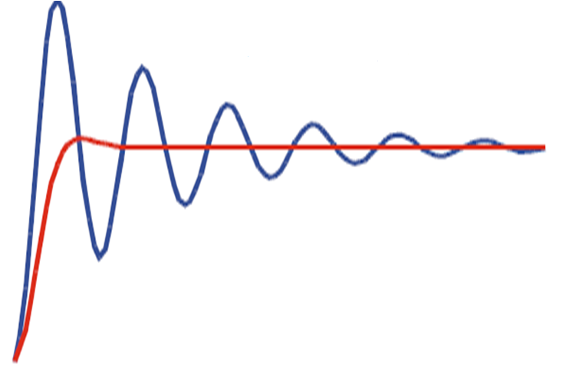
Control
A Control system performs following functions
For particular input the system output can be controlled to a desired particular value.
If some conditions are satisfied it can give a particular sequence of events as output corresponding to given input
Actual Response
Desired Response

Slide 5
Open Loop Control
Output is dependent on input but controlling action is totally independent of the changes in output, is an Open Loop Control System.
No feedback is used, so the controller must independently determine what signal to send to the actuator.
u
Input
Control Law
Plant
Output
Plant = Mathematical model of Input Amplifier + Actuator + Physical System
Input = Reference / Desired Input or Set Point Input
Output = Measured Output
Control Law = Mathematical model of the Controller

Slide 6
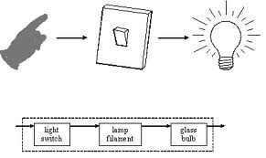
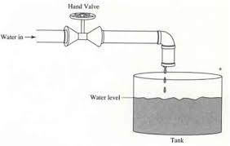
Examples of Open Loop Control

Slide 7
Advantages and Dis-advantages of Open Loop Control
Advantages:
Simple in construction
Low cost
Convenient to implement when output is difficult to measure
Disadvantages:
The controller never actually knows if the actuator did what it was supposed to do, i.e. it is inaccurate
Unable to sense the environmental changes or disturbances

Slide 8
Closed Loop Control
Controlling action is dependent on the changes in output
+
∑
e
u
Input
Control Law
Plant
Output
_
e = Error = Input – Output
u = Control Input

Slide 9
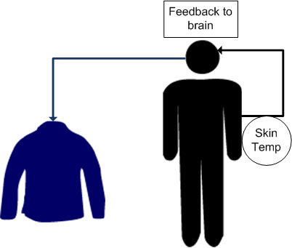
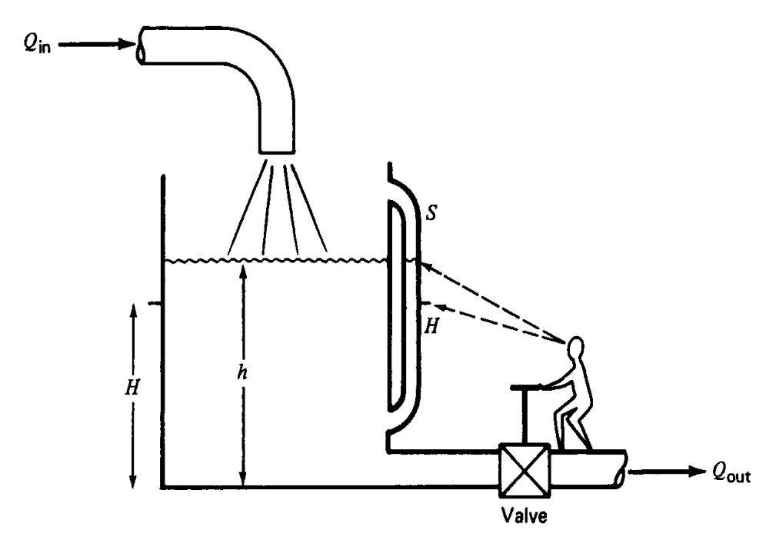
Examples of Closed Loop Control

Slide 10
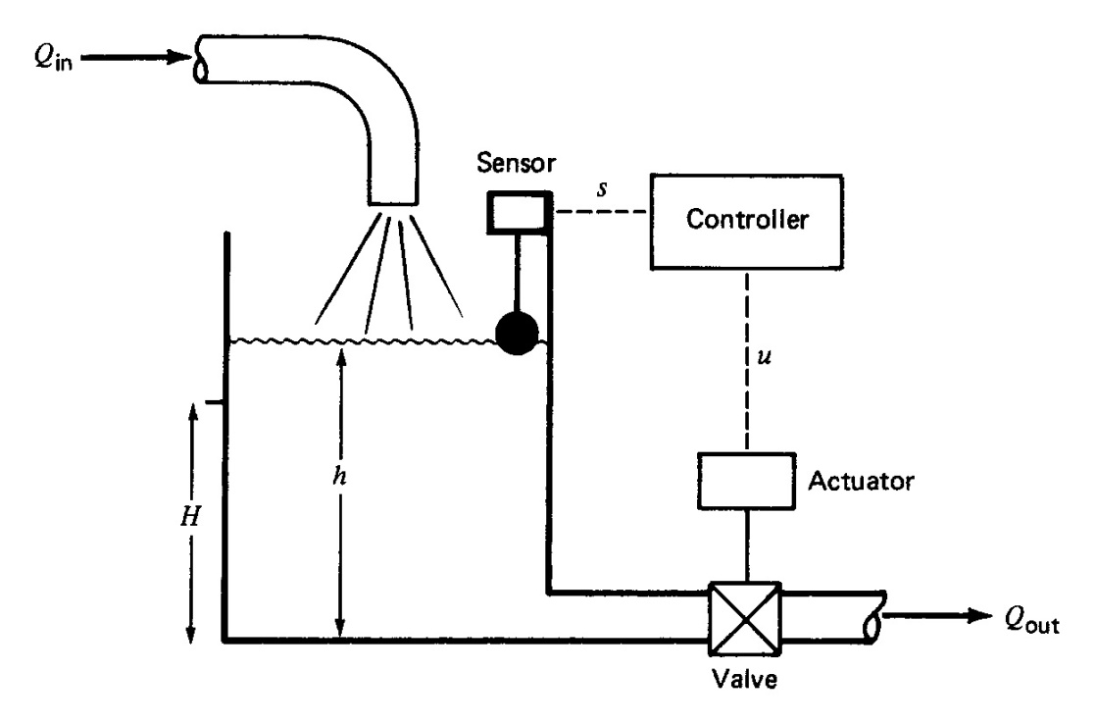
Examples of Automatic Closed Loop Control

Slide 11
Advantages and Dis-advantages of Closed Loop Control
Advantages:
Accurate, since the controller modifies and manipulates the actuating signal such that the error in the system will be zero.
Self-correcting
Senses the environmental changes, and disturbances in the system.
Disadvantages:
Complicated to design
Costly
Instable, since due to feedback , system tries to correct the error.

Slide 12
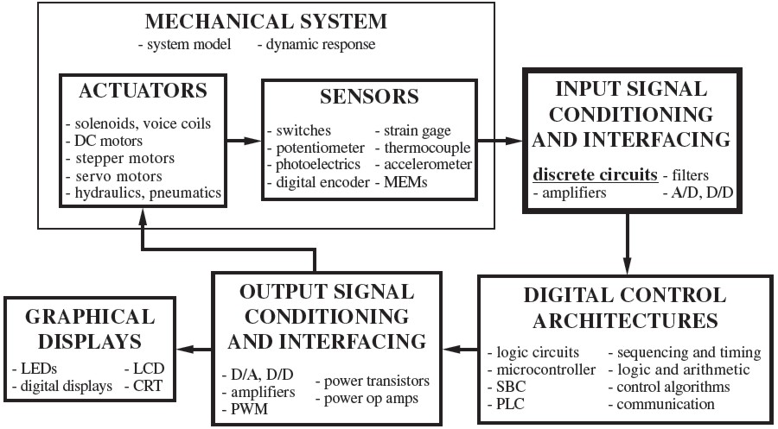
Key Elements in Mechatronic System

Slide 13
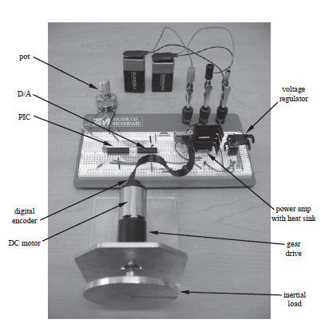
Elements in Mechatronic System
Example:
Electro-Mechanical System

Slide 14
Response of System
Notes:
Response of system can be generated either through experiments or by simulation of the mathematical model of the system.
5 different responses are shown in above figure. These are all unit step responses.
The Blue response is for a critically damped, stable system. The Green one is for a marginally stable system. The Red one is un-stable system. The Cyan one is for under damped, stable system. The Purple one is for un-damped system.

Slide 15
Transfer Function Models
Why TF?
Because it is easier / better to assess some things using classical techniques, such as gain and phase margin.
How to determine TF?
Derive the Governing Differential Equation
Assume I.C=Zero and
Take Laplace transform of output
Take Laplace transform of input
Transfer function = L (output) / L (input)

Slide 16
Translational Mechanical Example 1

Slide 17
Translational Mechanical Example 1

Slide 18
Block Diagram
Block diagram is a diagram of a system in which the principal parts or functions are represented by blocks connected by lines that show the relationships of the blocks

Slide 19
Block Diagram
Comparator
Input/Reference/Output/Disturbance / Feedback Signal
Blocks to represent:
Sensor, Actuator, Plant, Controller, Amplifier etc (in symbolic form / transfer function form)
Subsystem is represented as a block with an input, an output, and a transfer function
When multiple subsystems are interconnected, a few more schematic elements must be added to the block diagram
These new elements are summing junctions and pickoff points.

Slide 20


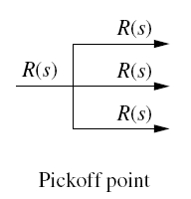
Block Diagram: Domain & Comparator

Slide 21
Reduction techniques
1. Combining blocks in cascade or in parallel
2. Moving a summing point behind a block

Slide 22
3. Moving a summing point ahead of a block
4. Moving a pickoff point behind a block
5. Moving a pickoff point ahead of a block

Slide 23


6. Eliminating a feedback loop
$$\frac{G}{1+GH}$$
$$\frac{G}{1−G}$$
7. Swap with two neighboring summing points

Slide 24
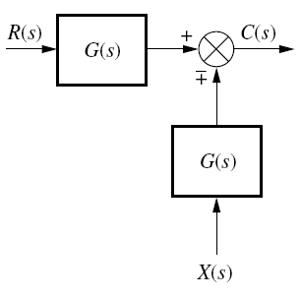
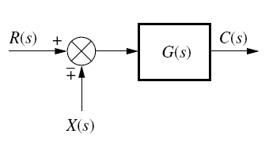
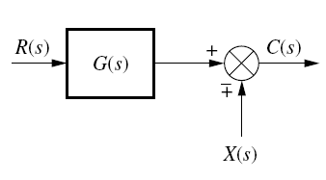
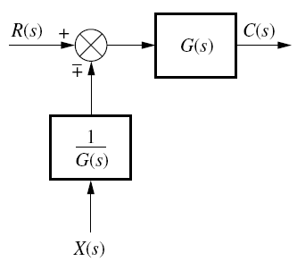
Test question 1

Slide 25
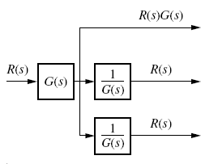
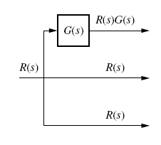
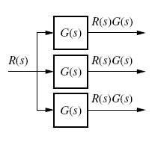
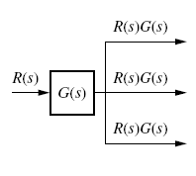
Test question2

Slide 26
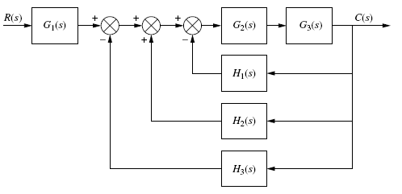
Example 1

Slide 27
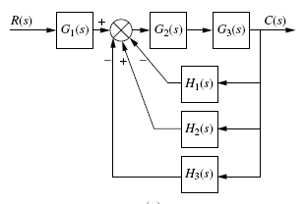
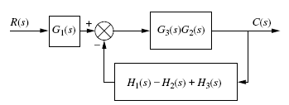
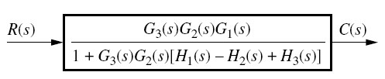
Example 1

Slide 28
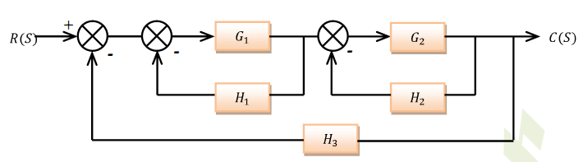
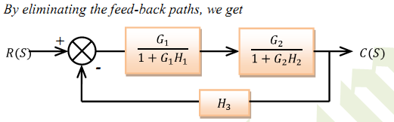
Example 2

Slide 29
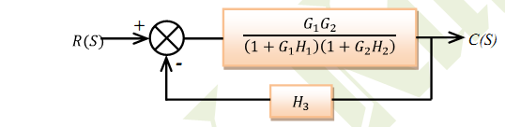
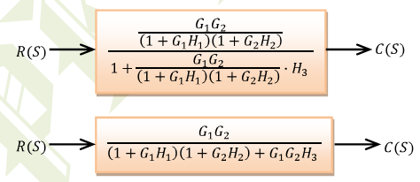
Example 2

Slide 30
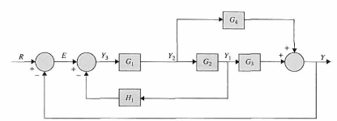
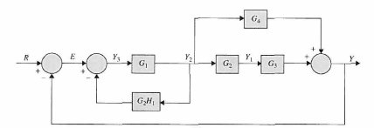
Example 3

Slide 31



Example 3

Slide 32
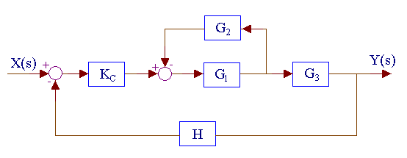
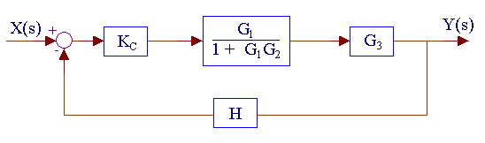

Example 4

Slide 33
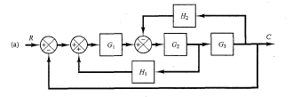
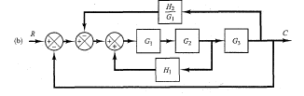
Example 5

Slide 34

Example 5

Slide 35

Example 5

Slide 36
Example 5

Slide 37
Applications of Mechatronic System
Household
Refrigerator
Washing m/c
Microwave
Automotive
Power steering
Air conditioner
Shop floor
Tool monitoring system
Automated guided vehicle
Conveyor system
Bottle filing plant.

Slide 38
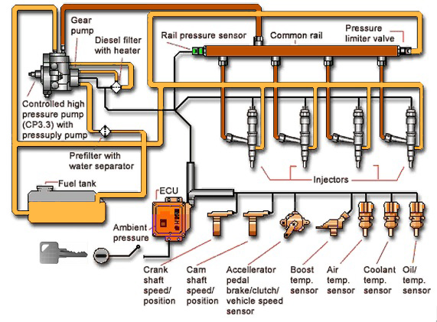
Fuel Injection

Slide 39
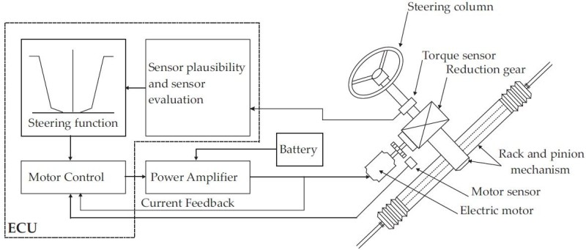
Electric Power Steering

